Slide 1





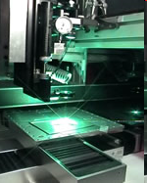
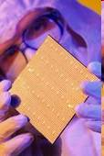
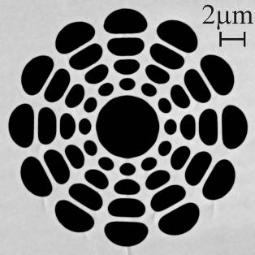
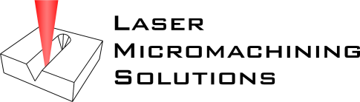
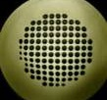
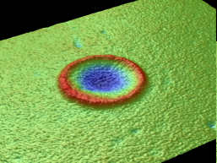
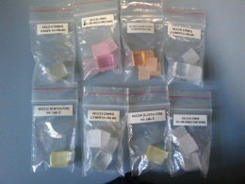


Michael Withford
(Node Director)
OptoFab Node
Tanya Monro
Heike Ependorff-Heidepriem
Luis Lima-Marques
Simon Fleming
Richard Lwin
Alex Arygos
Eric Magi
Specialty Fibres, Biosensors, glass chemistry
Specialty fibre fabrication (mPOF)
Tapering, characterisation
Ben Johnston
Rob Williams
Marty Ams (makes it look pretty ☺ )
Dave O’Connor
Cleanroom facilities
Photomask fabrication
Notes:
1

Slide 2

Overview
Synergies within the OptoFab node. e.g. ZBLAN waveguide laser
Benefits of NCRIS and EIF schemes
Laser micromachining at Macquarie, existing and new facilities
Some successful projects
  MNRL at Monash
  Melbourne University diamond devices
  Ge nano-electronics at UNSW
- Recent benefactors at USyd and MQ

Slide 3
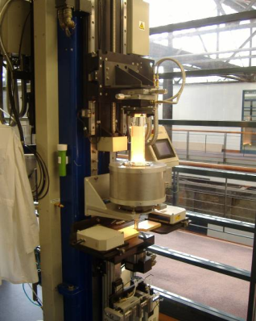
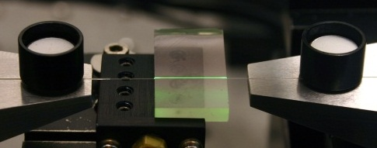
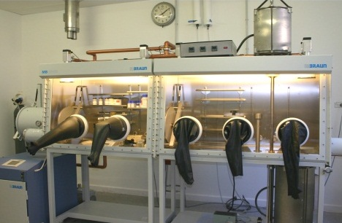
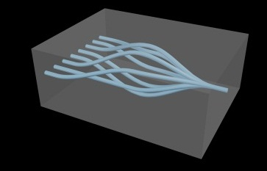
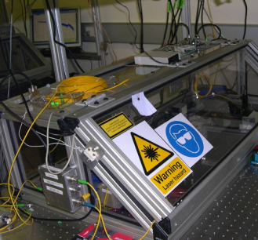
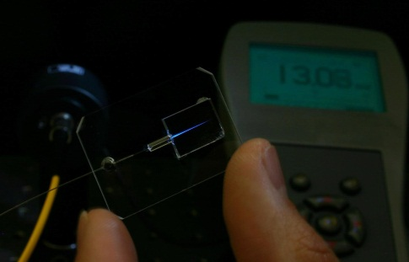
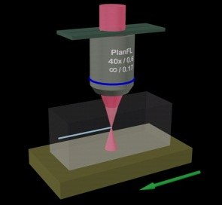
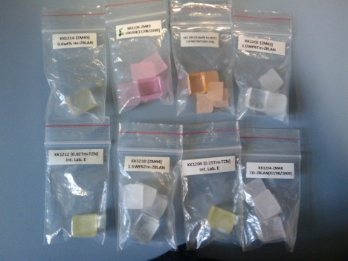
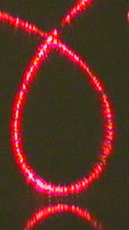
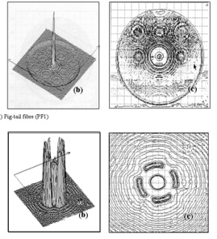
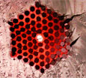
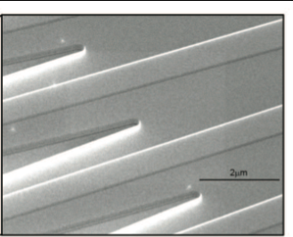
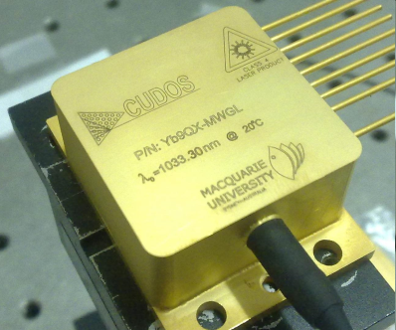
Node Synergies…
Future Vision: Providing a start to finish approach to glass and polymer photonics
Fibre design and Fab…
Assembly and
packaging..
Modification and
characterisation..
Materials…
3D and planar
fabrication…

Slide 4
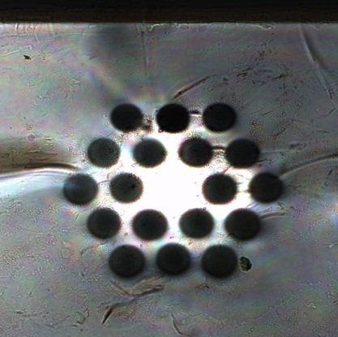
Internal example
ZBLAN waveguide laser
S. Gross¹, D. Lancaster², H. Ebendorff-Heidepriem², K. Kuan², T.M. Monro², M. J. Withford¹, and A. Fuerbach¹
¹Centre for Ultrahigh bandwidth Devices for Optical Systems (CUDOS),
MQ Photonics Research Centre, Department of Physics and Astronomy, Macquarie University, NSW 2109, Australia
²Institute for Photonics and Advanced Sensing (IPAS)
School of Chemistry and Physics, The University of Adelaide, SA, 5005, Australia
Input coupler mirror
Output coupler mirror
Top surface
0.1 NA 25 µm core fibre
Collimation and launch optics
Silicon filter
9 mm Tm:ZBLAN sample
1880 nm output
790 nm pump light
f = 20 mm
f = 20 mm
HR @ 2000 nm
HT @ 790 nm
OC @ 2000 nm
50 µm

Slide 5
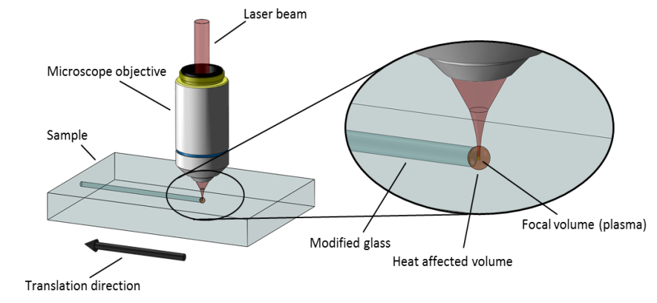
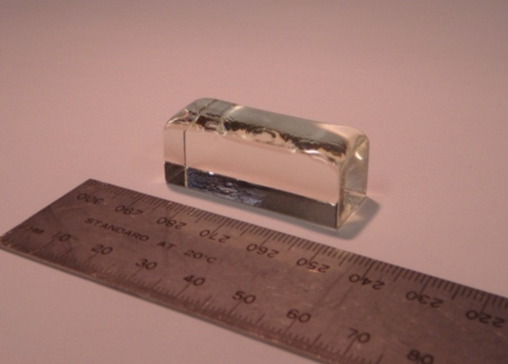
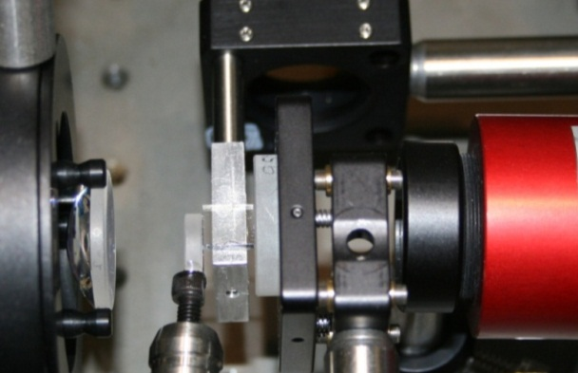
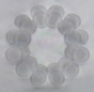
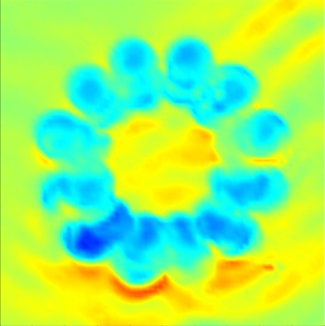
Ingot of Tm³⁺ doped ZBLAN, fabricated from melt at University of Adelaide.
Laser assembly and characterisation at Adelaide
Femtosecond laser inscription of waveguides and characterisation at Macquarie
Goal: to make this type of interaction with OptoFab happen for a wide range of users. (And in the long term $elf $ustaining)

Slide 6
Track Record
Solid growth
Large external user base
  2009-10 reporting period = 64%
Track record industry / PFRA interaction
  2009-10 reporting period = 17%
User satisfaction - high
OptoFab

Slide 7
Benefits due to NCRIS & EIF support
NCRIS Investment:
Optofab established on existing facilities
  Infrastructure ranging from low to high tech
  Predominantly customised systems
EIF Investment:
Build new, transformational facilities
  Many customised systems
  Increased emphasis on integration
  Large scale wafer, optical lithography
OptoFab

Slide 8
Benefits due to NCRIS & EIF support (cont.)
OptoFab
NCRIS Investment:
Major benefits
  facilitate access to established, mature expertise
  ensure continuity of expertise
  support facility operating / maintenance costs
EIF Investment:
Major benefits:
  Enable open access to emerging expertise
  Fast track development of emerging expertise
    personnel + equipment

Slide 9
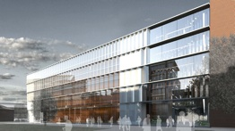
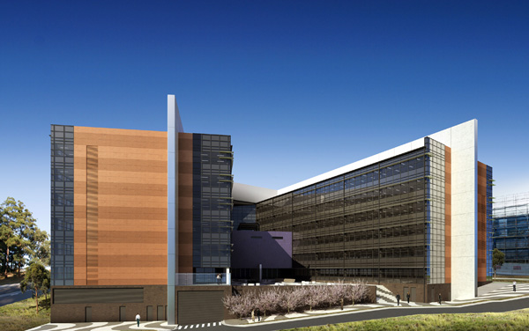
New Home for Optofab
Institute for Photonics & Advanced Sensing (IPAS) Building, University of Adelaide
$95M purpose-built building, HEEF, Uni & State Government support
  Ready for occupancy 2013
50% of the building dedicated to research facilities for optical materials science, optical fibre fabrication, laser development, surface science and sensor research
Laboratories that bring together biological and photonics capabilities
Australian Institute for Nanoscience
- University of Sydney
10,500 m² building
  $110M, EIF Super Science $40M
  Ready for occupancy 2013 – 2014
Purpose-built Nanofabrication Facility – 1200 m² clean room
Photonics - prime reason for this facility
  Co-locate with quantum science
Bandwidth Foundry, with i-line stepper and DWL, to re-locate
Australian Hearing Hub
- Macquarie University
Approx 20,000 m² building
  $140M, HEEF and Uni
  Ready for occupancy late 2012
Purpose-built Fabrication Facility
  >200 m² low vibration (VC-E)
  >100 m² office space
Relocate laser micromachining facilities, sample preparation and characterisation
Co-located with Cochlear (R&D), Aust. Hearing Associations, and non-for-profit organisations
Artist impression (USyd)
Artist impression (UAdel)
Artist impression (Macq)
9

Slide 10
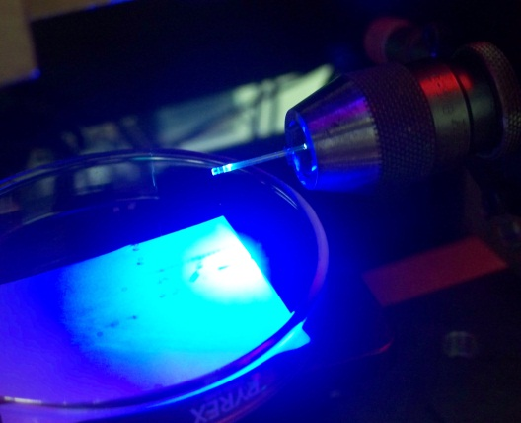
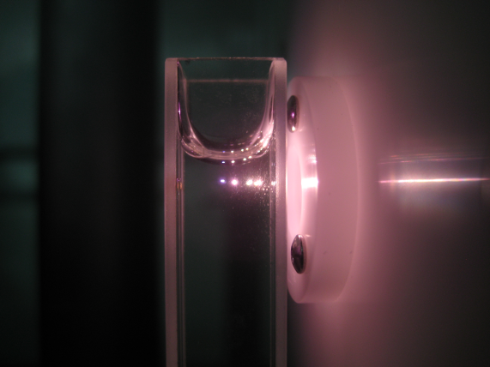
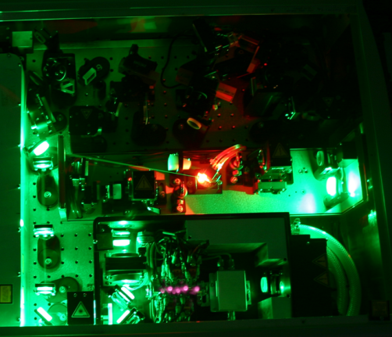
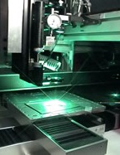

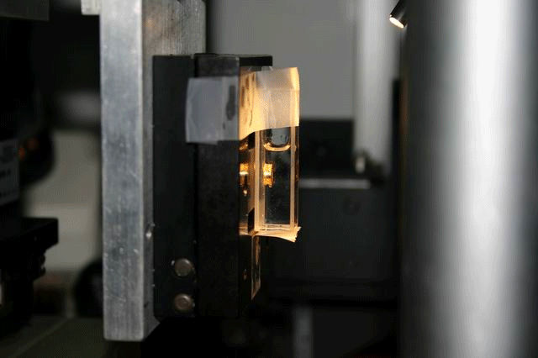
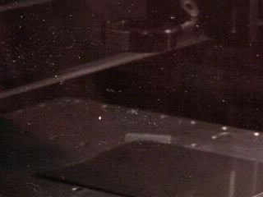
Laser Micromachining
Notes:
10

Slide 11
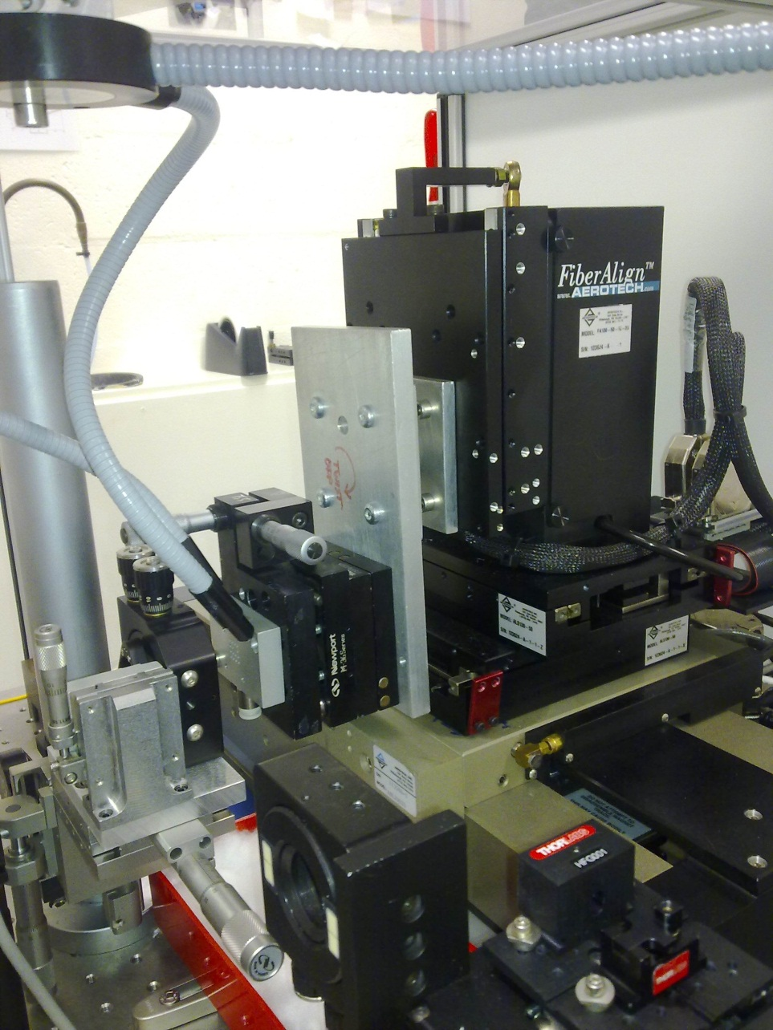
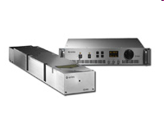
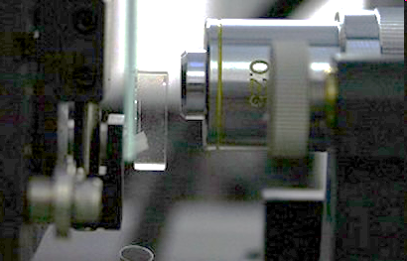
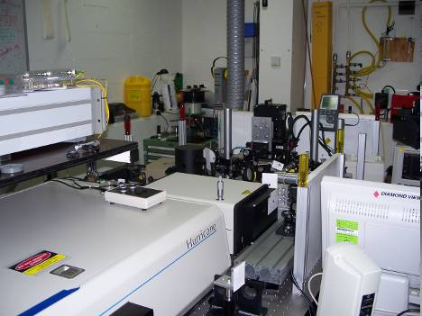
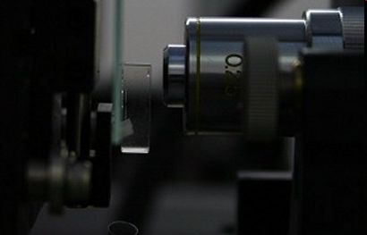
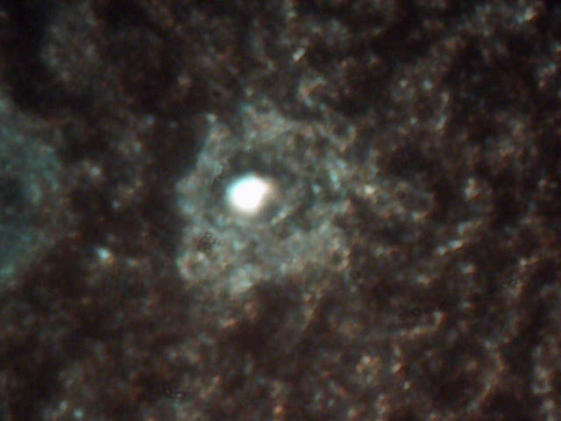
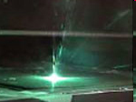

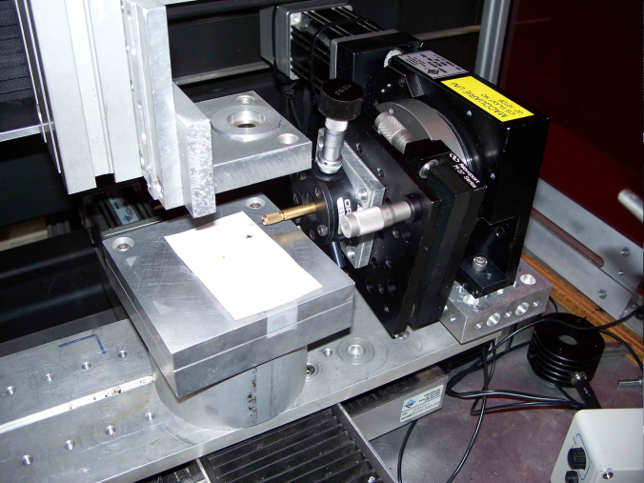
MQ Facilities
Exisiting facilities supported by NCRIS from 2008
- Nano-second Vis-UV laser machining facility (JDSU Q-series 532nm)
- Limited time on the Hurricane Femtosecond system
- Aerotech ATS-100 stages and controller
- Aerotech Fibre align stages with 30cm air-bearing stage and controller

Slide 12
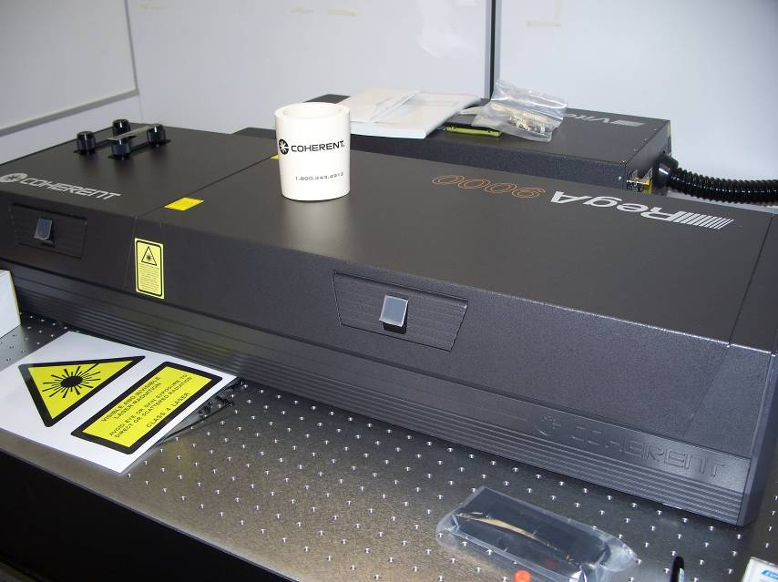
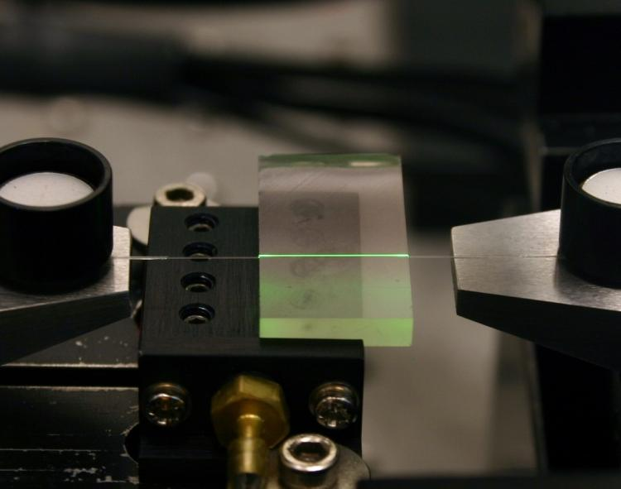
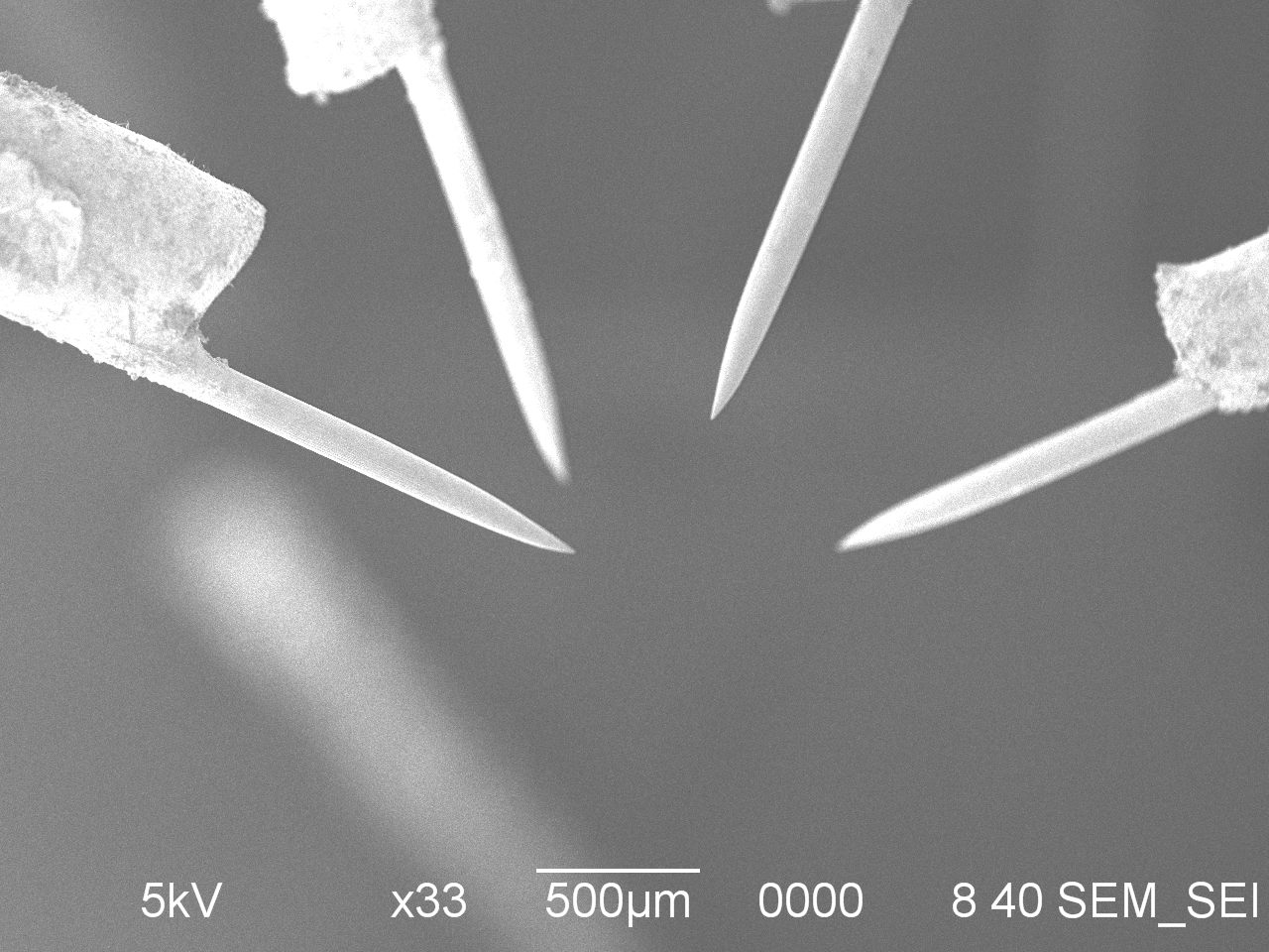
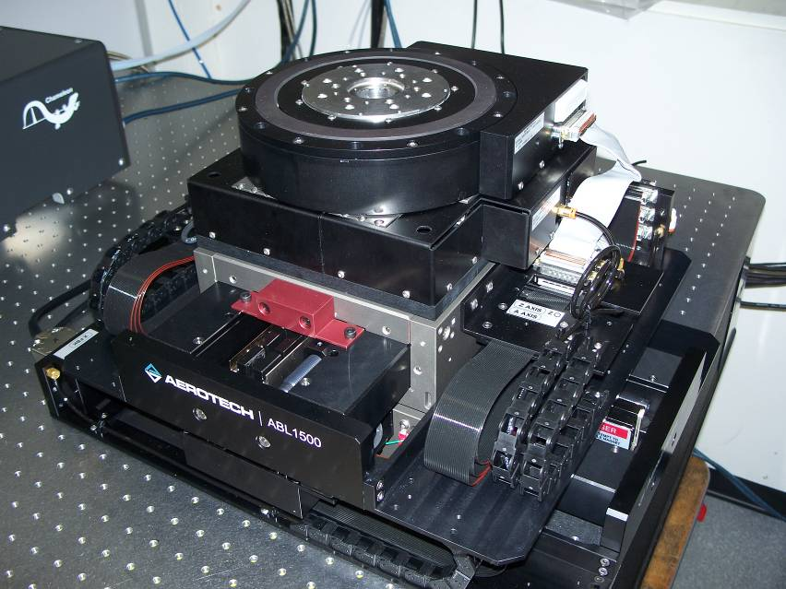
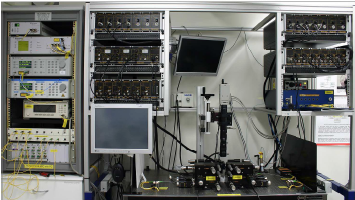
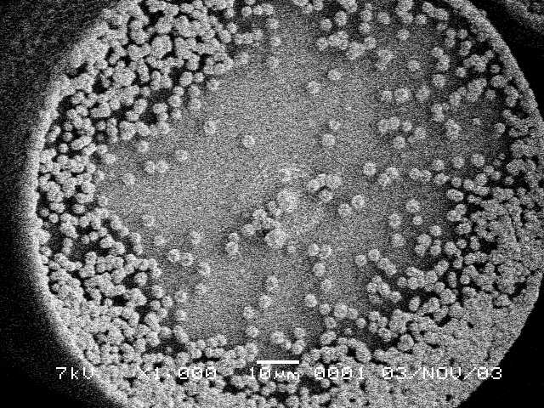
MQ Facilities (Coming soon)
New facilities Funded by EIF from 2010
RegA Femtosecond Laser Facility
Diamond MOCVD and nanoassembly facility
Optical characterisation suite

Slide 13
Some projects…

Slide 14
MNRL at Monash
Good match with our capabilities
Great people to work for;
patient, happy to work through several iterations of a part
Generous with cross promotion
Publish often and with acknowledgments
Attract good press
Now heavily involved with ANFF in Melbourne and understand the deal.
Prof. James Friend
Dr. Leslie Yeo
$7mill in funding with projects in microfluidics, acoustics, piezoelectrics, micromechanical systems, drug delivery….

Slide 15
Laser Micromachining Solutions (MQ)
Testimonial: A/Prof James Friend – Monash University, Aug 2009
  “When we started this work, we chose XXXXXXX, a popular laser machining job shop in the US in theory capable of addressing our needs. The results were—politely stated—abysmal. After learning of A/Prof Withford’s facility, we tried their services and the result has been.....:”
  2 Provisional Patents
  4 journal papers
  2 successful grant application + 2 more pending.

Slide 16
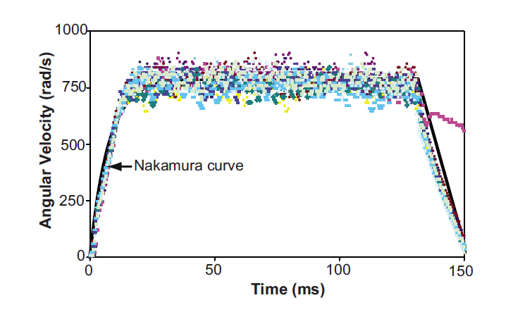
MNRL at Monash
^{Concept:}
http://www.youtube.com/watch?v=VRMEtCCDR_E
Principle:
Piezo driven mechanical resonance for producing good torque and RPMs in a machine of the order of 1mm³
Progess:
~130 RPS
7800RPM
Brett Watson, Leslie Yeo, and James Friend, A study on axial and torsional resonant mode matching for a mechanical
system with complex nonlinear geometries, REVIEW OF SCIENTIFIC INSTRUMENTS 81, 063901 2010

Slide 17
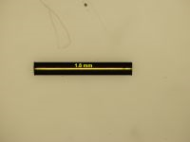

What we make…
- Start with 32G (230um) hypodermic tube
- Stages in a lathe configuration
- 10-50mW of 266nm ns pulses, 500Hz.

Slide 18



Turn and burn…
Other bits:
Rotor for measuring the RPM, cut from 25um copper
- 0.5mm long
11 turns/mm
Two tracks (180deg)
Cuts ~80% of the way through sidewall for best resonance performance
Lots of iterations to get it right
Propeller tails to make it swim (coming soon)
http://www.youtube.com/user/MNRLMonash?blend=2&ob=1#p/u/11/XYdlA4Pv9Rg Earlier model with a few RPM

Slide 19



Variations…
- Slotted stator for 3 axis articulation
Blade type propellers (300um span)

Slide 20





Diamond at Melbourne University
Diamond electrode array sectioning
Plumbing ports for Diamond microfluidics

Slide 21



Another successful user…

Slide 22

Ge nanoelectronics at UNSW CQCT
G Scappucci, G Capellini, B. Johnston, W. M. Klesse, J. A. Miwa, and M Y Simmons.
A complete fabrication route for atomic-scale, donor-based devices in single-crystal germanium. Submitted to Nanoletters.
Abstract: Despite the rapidly growing interest in Ge for ultra-scaled classical transistors and innovative quantum devices, the field of Ge nanoelectronics is still in its infancy. One major hurdle has been electron confinement since fast dopant diffusion occurs when traditional Si CMOS fabrication processes are applied to Ge. We demonstrate a complete fabrication route for atomic-scale, donor-based devices in single-crystal Ge using a combination of scanning tunnelling microscope (STM) lithography and high quality crystal growth. The cornerstone of this fabrication process is an innovative lithographic procedure based on direct laser patterning of the semiconductor surface, allowing the gap between atomic-scale STM-patterned structures and the outside world to be bridged…..

Slide 23




Some recent benefactors at USyd
Cenk: - Multilayered Steel-Au-Steel discs for shear force compliance tests
Maryanne, Anna et.al.: - Patterning of metal coated PMMA arrays, THz meta material
Pourandokht: sub-10um pinholes

Slide 24




Some recent benefactors at MQ
Martin and Sandeep
Numbered grids on coverslides for observing the growth of stem cells from day to day
Josh Brown and Chris McMahon
- Moly parts for the nitride growth and synchrontron runs
- Masks for lithography and evaporation
Carlo and Torsten
50um grids for locating the AFM

Slide 25


Providing nano and micro-fabrication facilities for Australia’s researchers
www.anff.org.au

Slide 26
Thanks

